Slide 1

Provider Network Management (PNM) Module to
Provider Service Management (PSM)
A guide for certified providers

Slide 2
Introduction
The Provider Network Management (PNM) module will be in effect in October 2022.
Changes were made in PSM to successfully communicate with PNM.
Reason for the change: to reduce the administrative burden on providers
  PNM will streamline the process for provider certification by offering a centralized portal, thus reducing the administrative burden on providers.
This presentation will show you the enhancements our providers will experience.

Slide 3
PNM Home
A Quick overview of PNM

Slide 4
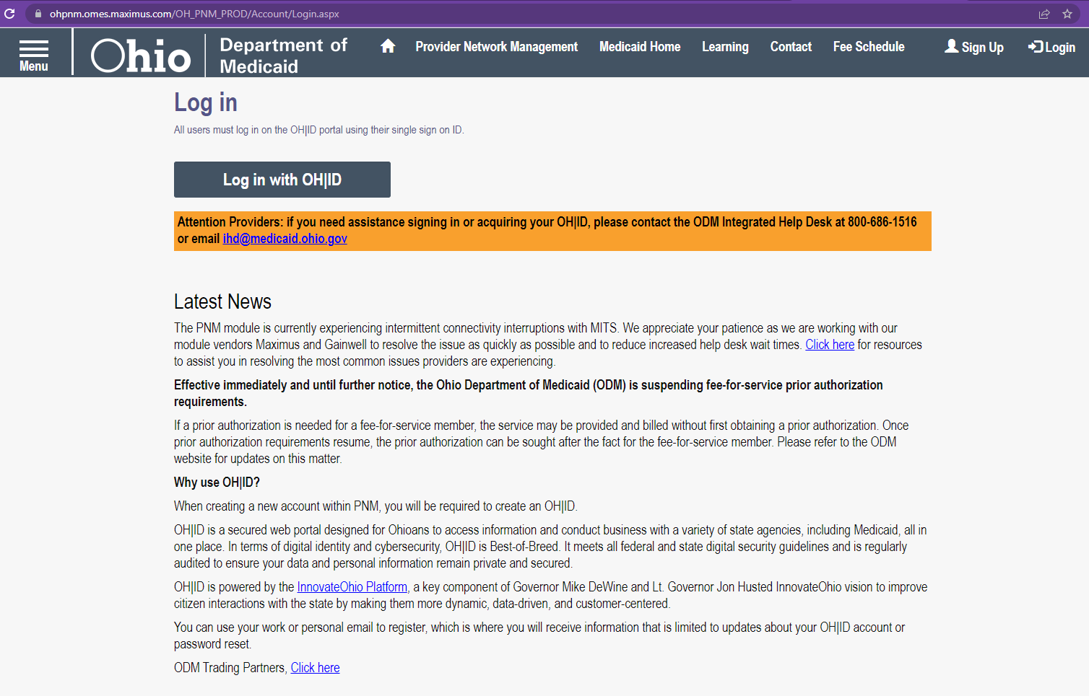
User Login Screen
https://ohpnm.omes.maximus.com/OH_PNM_PROD/Account/Login.aspx

Slide 5
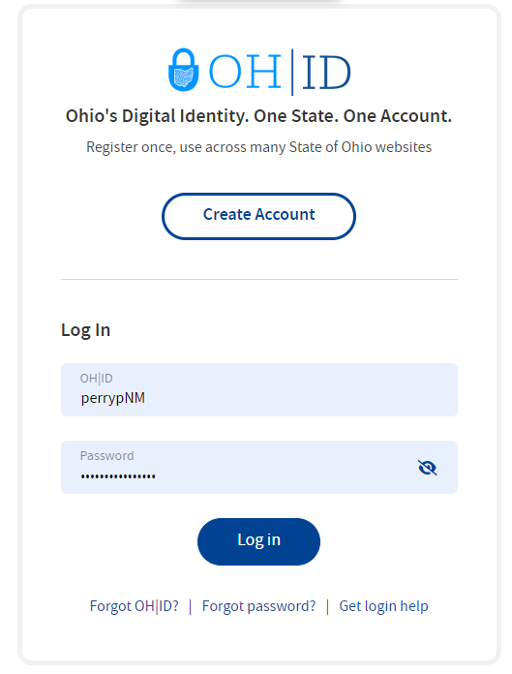
Log in with your OH|ID credentials

Slide 6
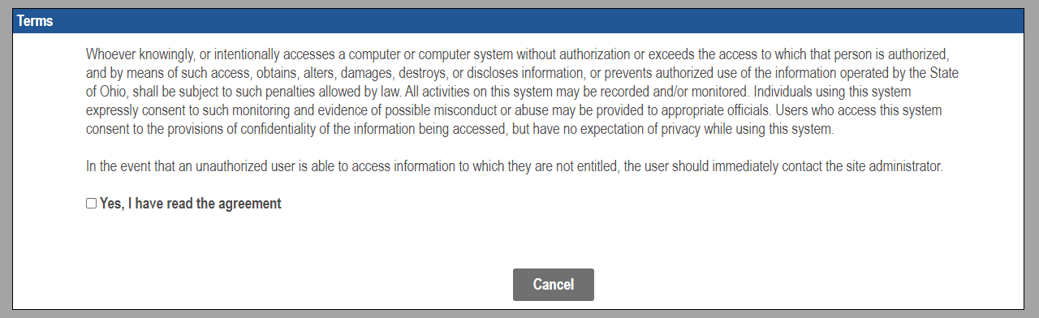
Check the box beside YES and wait
Warning: Selecting Cancel will begin the entire login process over again.

Slide 7
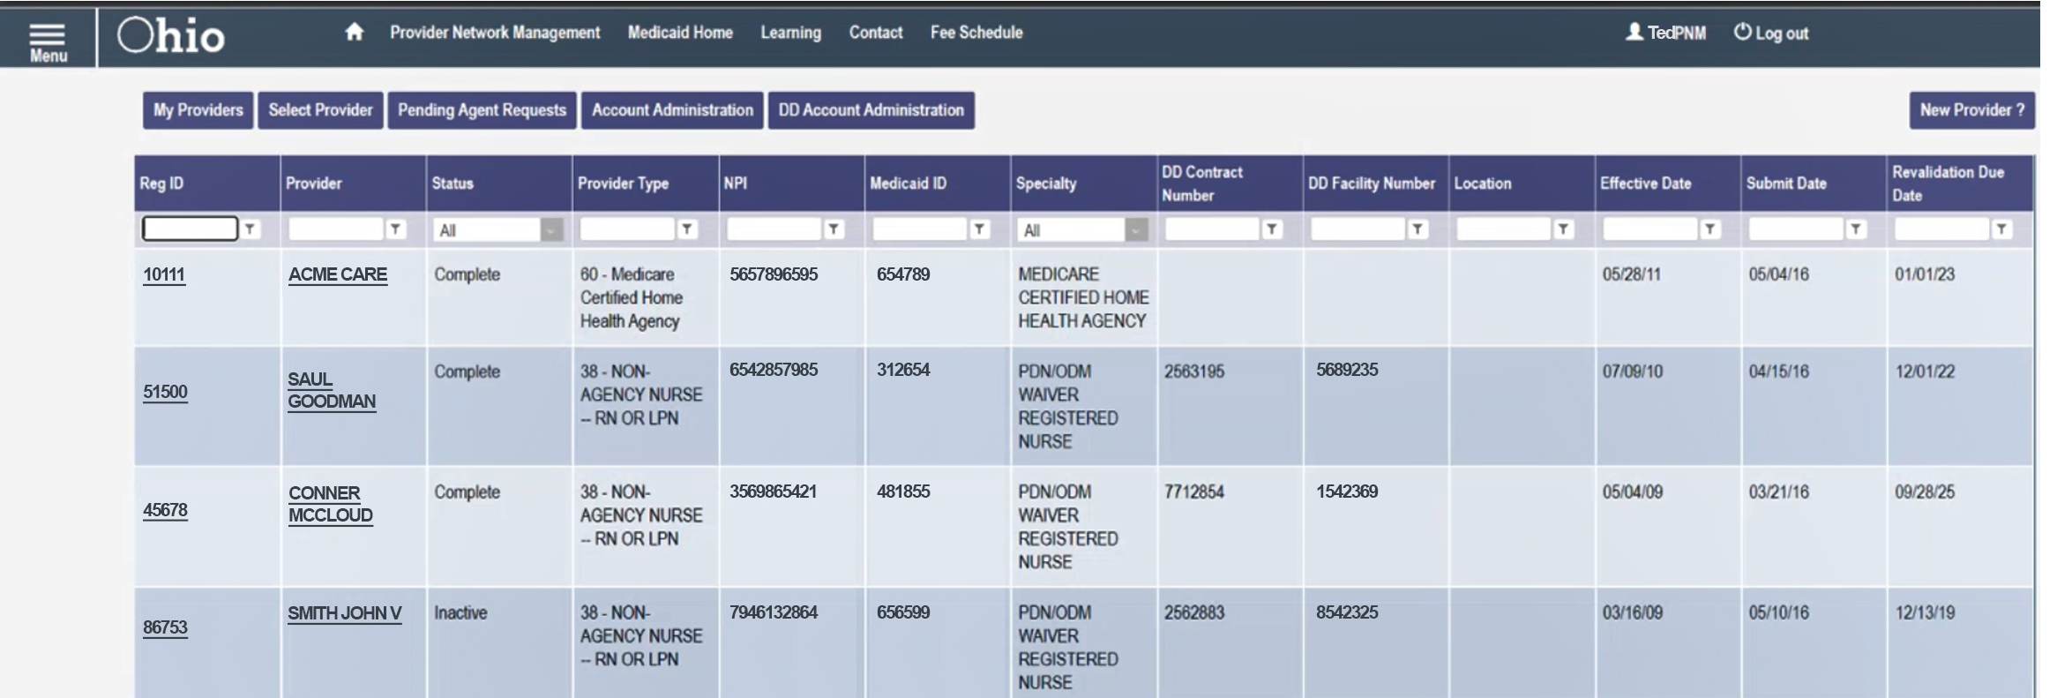
PNM Landing Page
Filter options are available for each column
Providers can only see the Reg IDs assigned to their user
Please click on your Reg-ID or Name to proceed

Slide 8
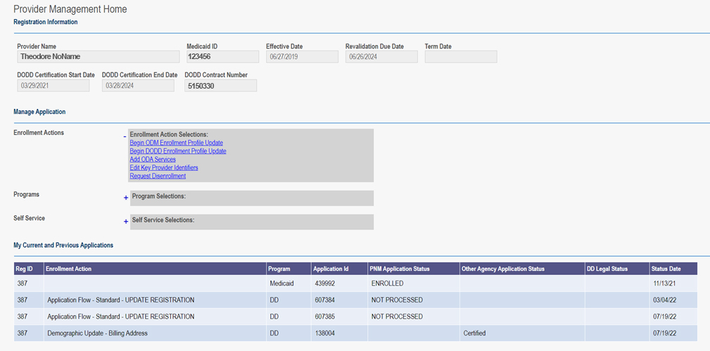
Provider Management Home Screen

Slide 9
Enrollment Actions
Begin ODM Enrollment Profile Update
Begin ODM application
Begin DODD Enrollment Profile Update
Route to PSM Provider Home
Add ODA Services
To apply for ODA certification
Make changes to the addresses except Billing and Payment
Complete any DODD contract update (Billing and Payment Addresses)
Add DODD certification to an SSA provider
Edit Key Provider Identifiers
ODM changes
Request Disenrollment
Removal of MPN/Medicaid ID and all certifications

Slide 10
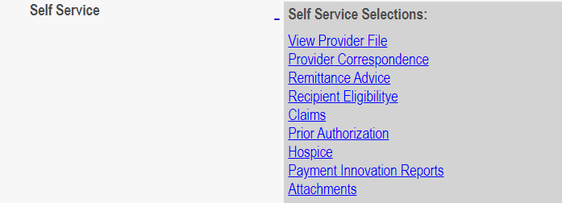
Programs and Self Service
Programs
  Nothing at this time; this will be for later development
Self Service
  ODM Information

Slide 11
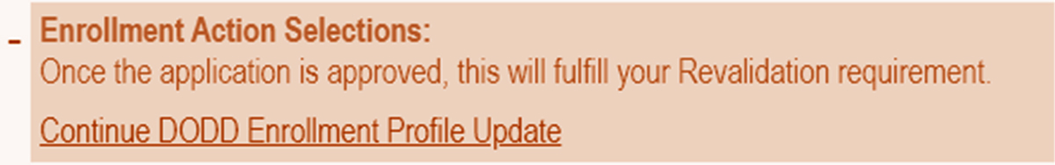
Updating your DODD contract
Choose the Begin DODD link for redirection to your contract in the PSM-Portal.
If any DODD applications are currently open, choose the Continue to DODD link (as seen below).

Slide 12
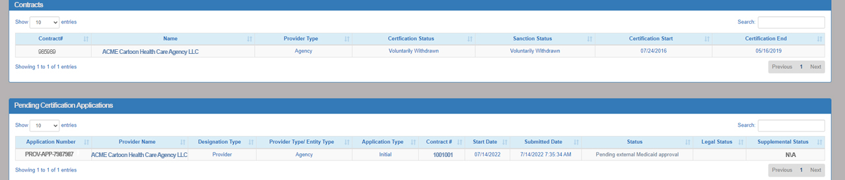
PSM Landing Page
Contracts will display as seen below.
Any pending applications will also display.
Access to Supplementals will be through status and not in an extra section.

Slide 13
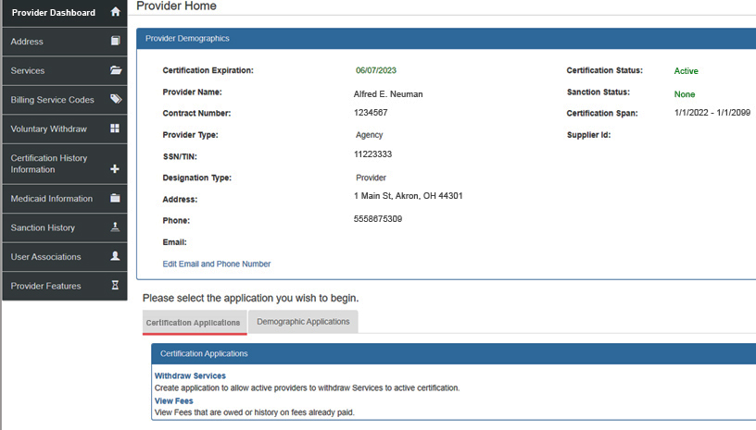
Provider Home
Tab options on left have been reduced
Each section will have tab subsections for better organization

Slide 14
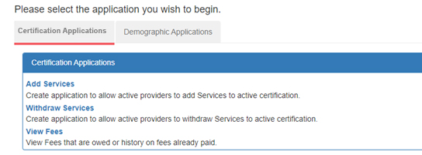
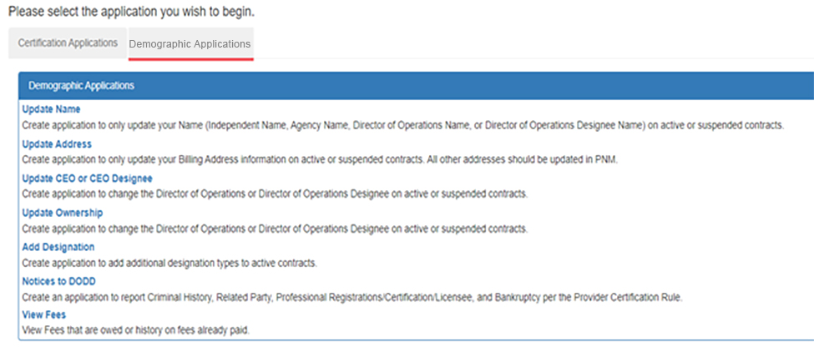
Applications
Certification Applications:
  Initial (when available)
  Add Services
  Withdraw Services
  Renewals (only displays when available)
Demographic Applications:
  Update Name
  Update Address (Billing and Payment only)
  Update CEO or CEO Designee (DOO or DOOD)
  Update Ownership
  Add Designation
  Notice to DODD
  View Fees

Slide 15
New Application Types
Ownership Update
Add Designation
Application only for an Agency Provider
To be completed when there is a change in ownership with the agency
Used to add another DODD layer to your Reg ID.
Examples:
  Non-Medicaid waiver Provider adding Medicaid waiver services
  Medicaid waiver Provider adding Licensee or Operator
  Licensee adding Provider (Medicaid or Non-Medicaid waiver services)
  Operator adding Provider (Medicaid or Non-Medicaid waiver services)

Slide 16
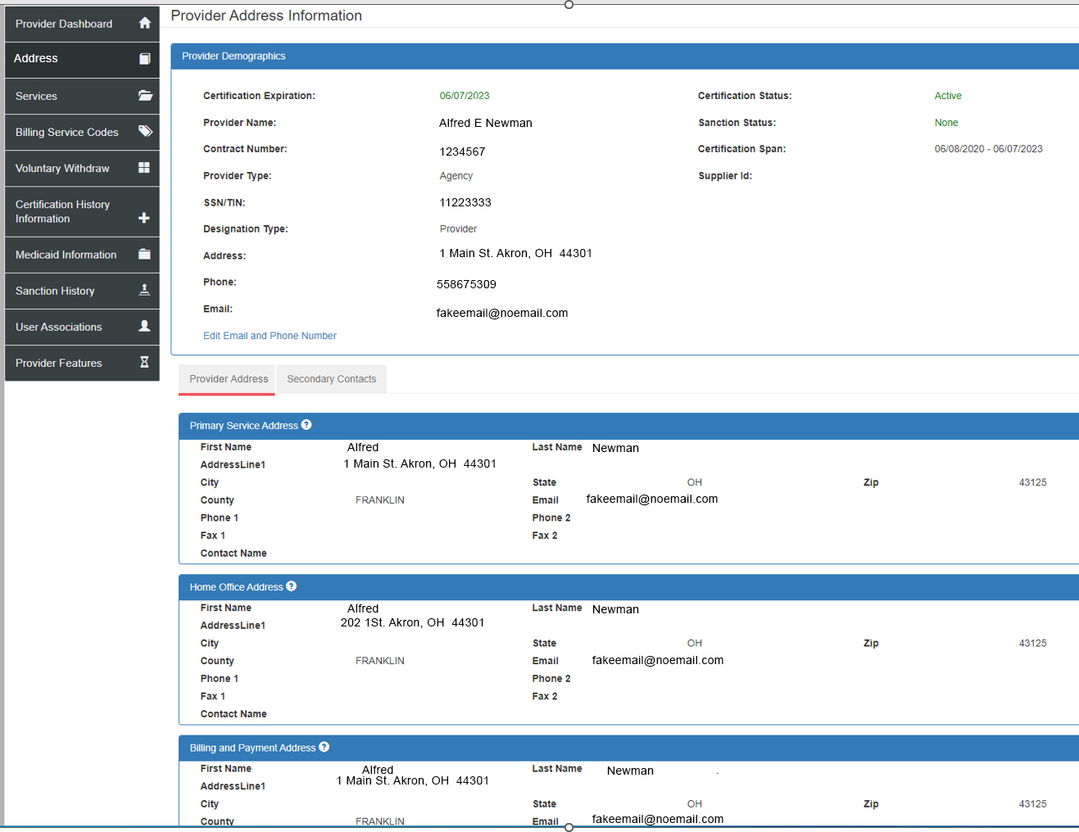
Address
Provider Address
Secondary Contacts

Slide 17
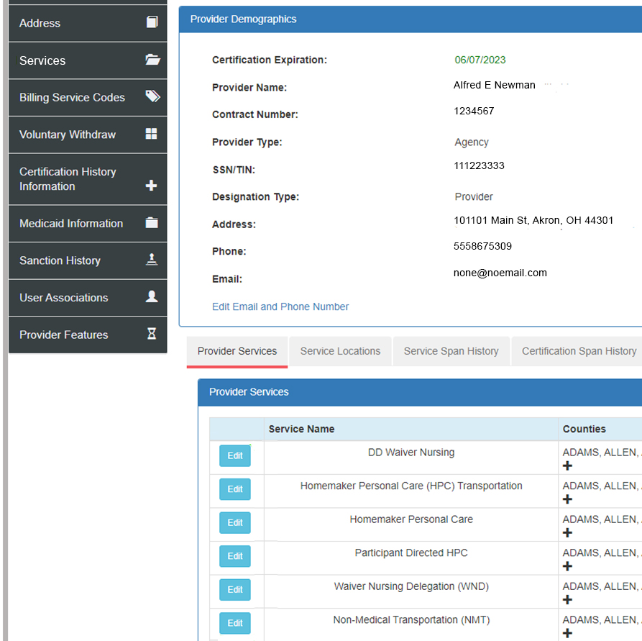
Services
Provider Services
Service Locations
Service Span History
Certification Span History
Add On Rates

Slide 18
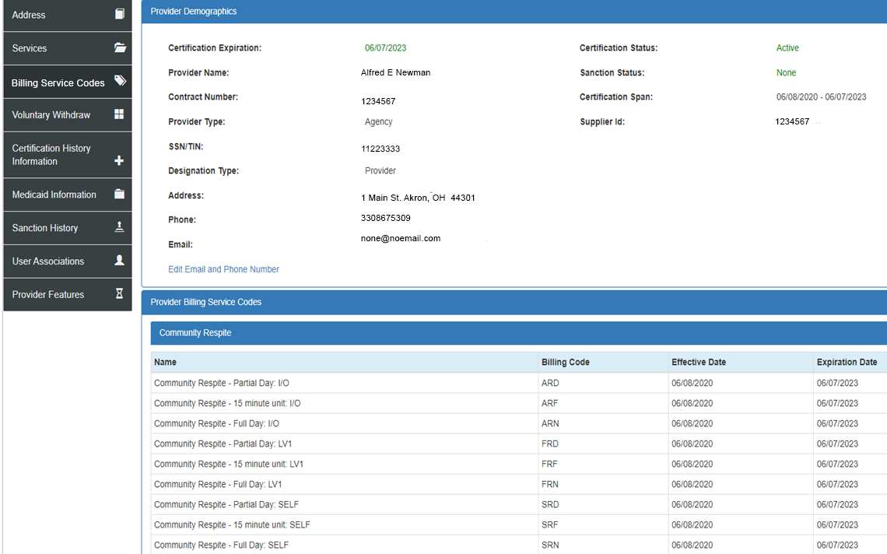
Billing Service Codes
All billing codes associated to the current contracted services

Slide 19
Voluntary Withdraw
To withdraw the full DODD certification

Slide 20
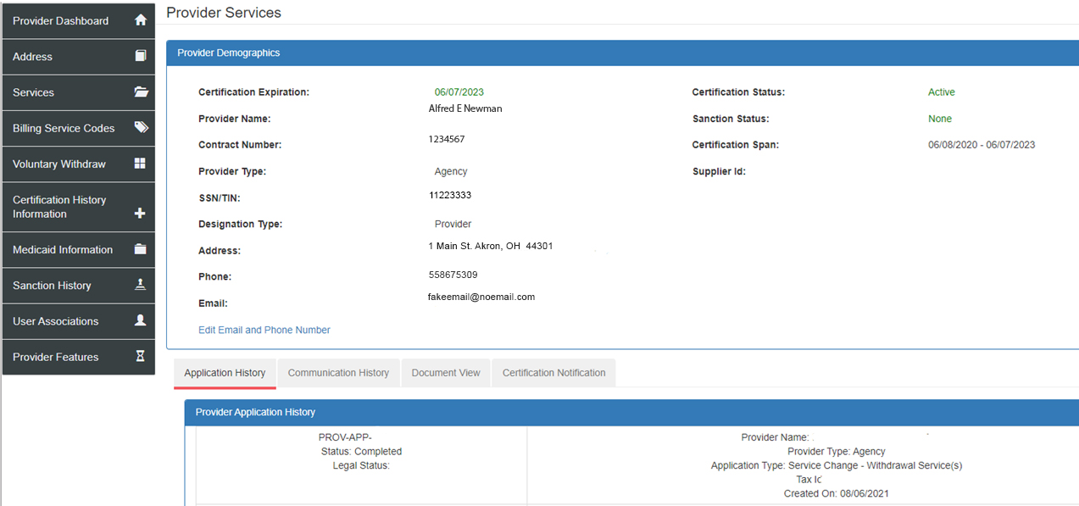
Certification History Information
Application History
Communication History
Document View
Certification Notification

Slide 21
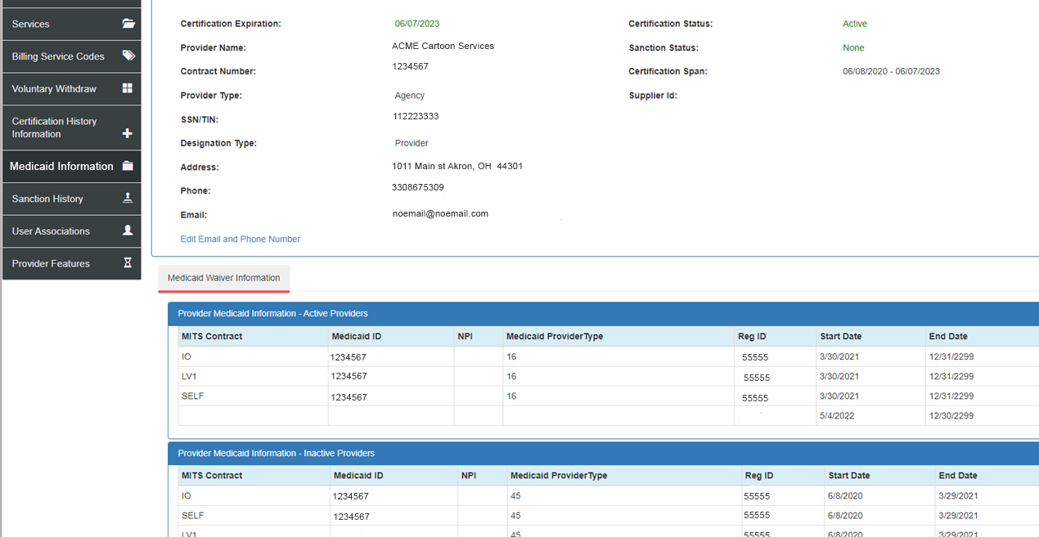
Medicaid Information
Medicaid Provider Number = Medicaid ID
NPI
Provider Type
Reg ID

Slide 22
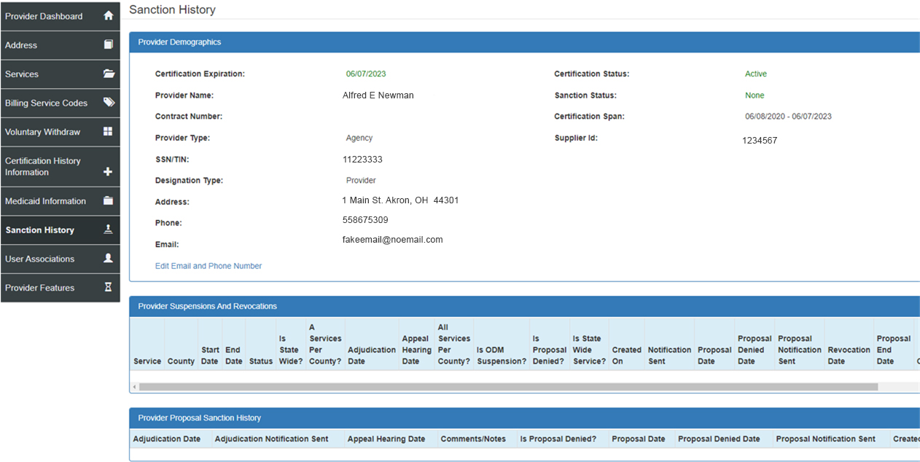
Sanction History
Current or Previous Sanction information will display.

Slide 23
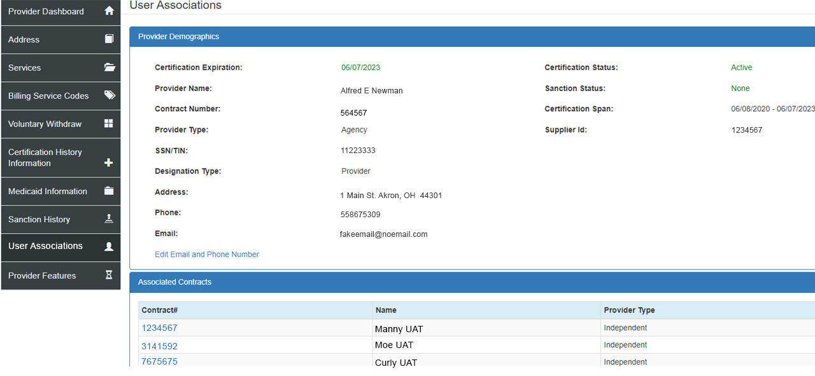
User Associations
Additional contracts that are linked to the user

Slide 24
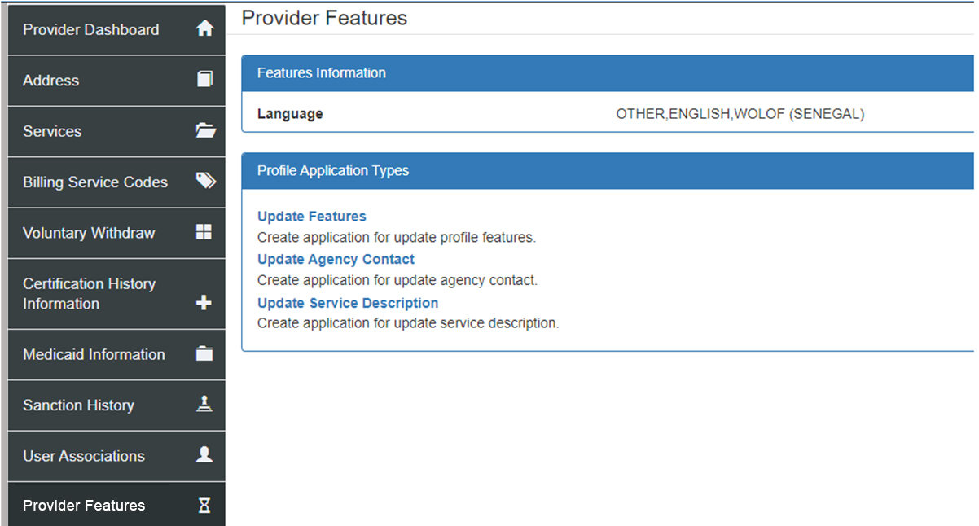
Provider Features

Slide 25
Contacts
DODD Provider Certification
Website – www.dodd.ohio.gov
DODD Waiver Providers – provider.certification@dodd.ohio.gov
DODD Licensure Development – licensuredevelopmentapps@dodd.ohio.gov
ODA Provider Certification
Website – www.aging.ohio/certification-changes
ODA Provider Certification – provider_inquiry@age.ohio.gov
PNM contact information
Ohio Department of Medicaid - ODM Integrated Help Desk (IHD) 1-800-686-1516
Email – IHD@medicaid.ohio.gov

